Slide 1
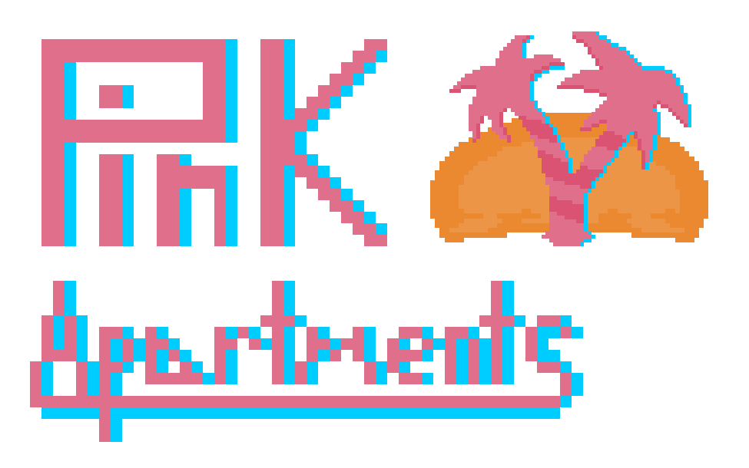
Tyler Hodzen, Troy Purvis, Jenna Lovett

Slide 2
Project Narrative
Simulates an administrative-focused database for an apartment complex
Includes data regarding apartments, contracts, residents, etc.
Insert data model here

Slide 3
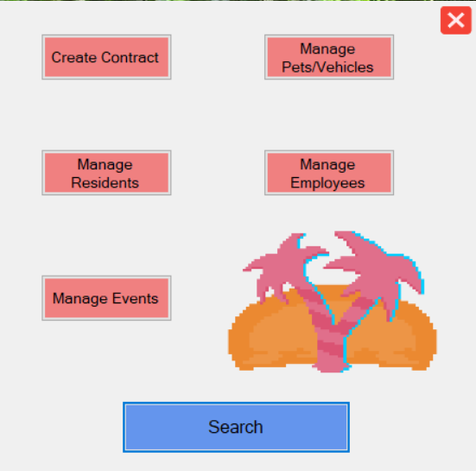
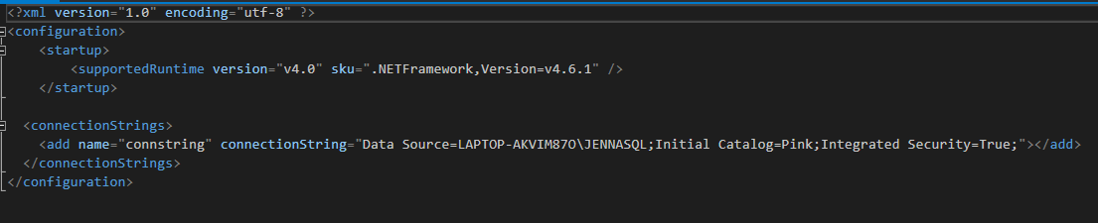
Software Stack
MS SQL Server + Visual Studio (C#/VB) = Windows Form Application

Slide 4
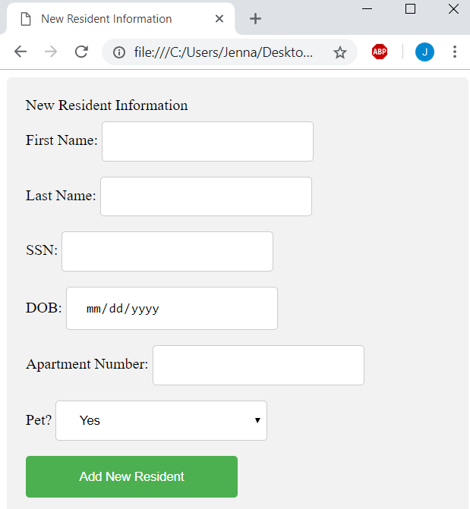
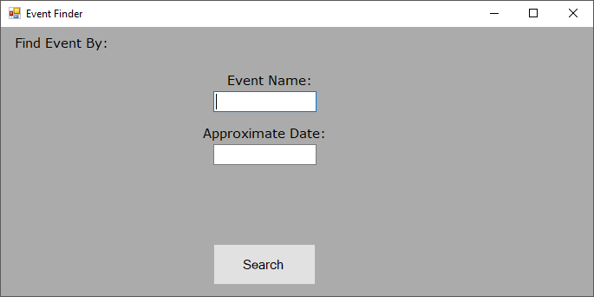

Slide 5
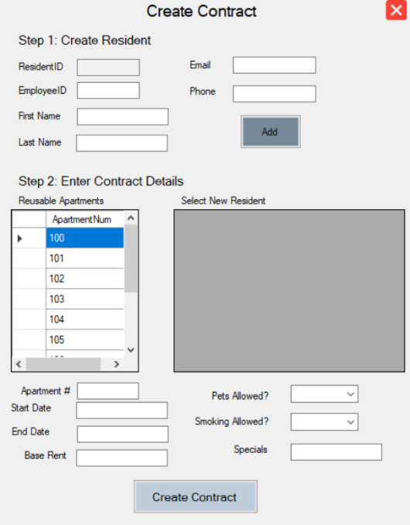
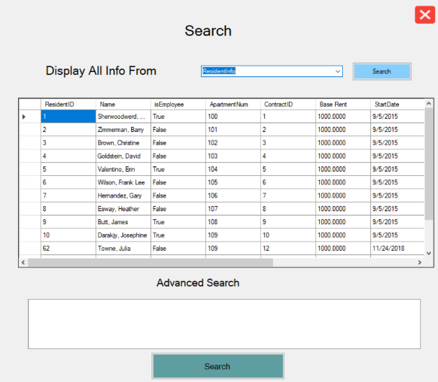

Slide 6
